Slide 1
Web Search Tool for Compliance AND ESG

Slide 2

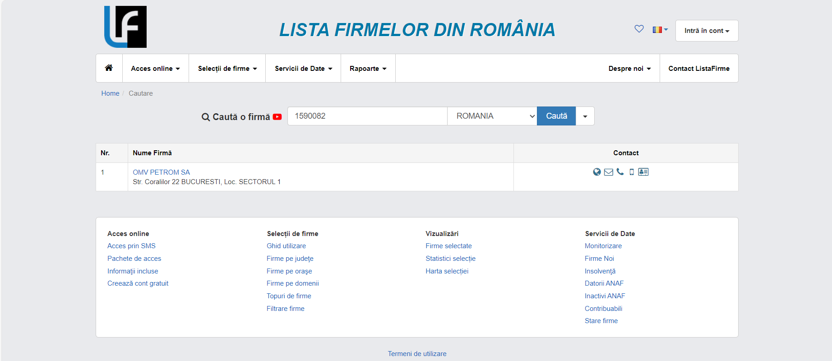
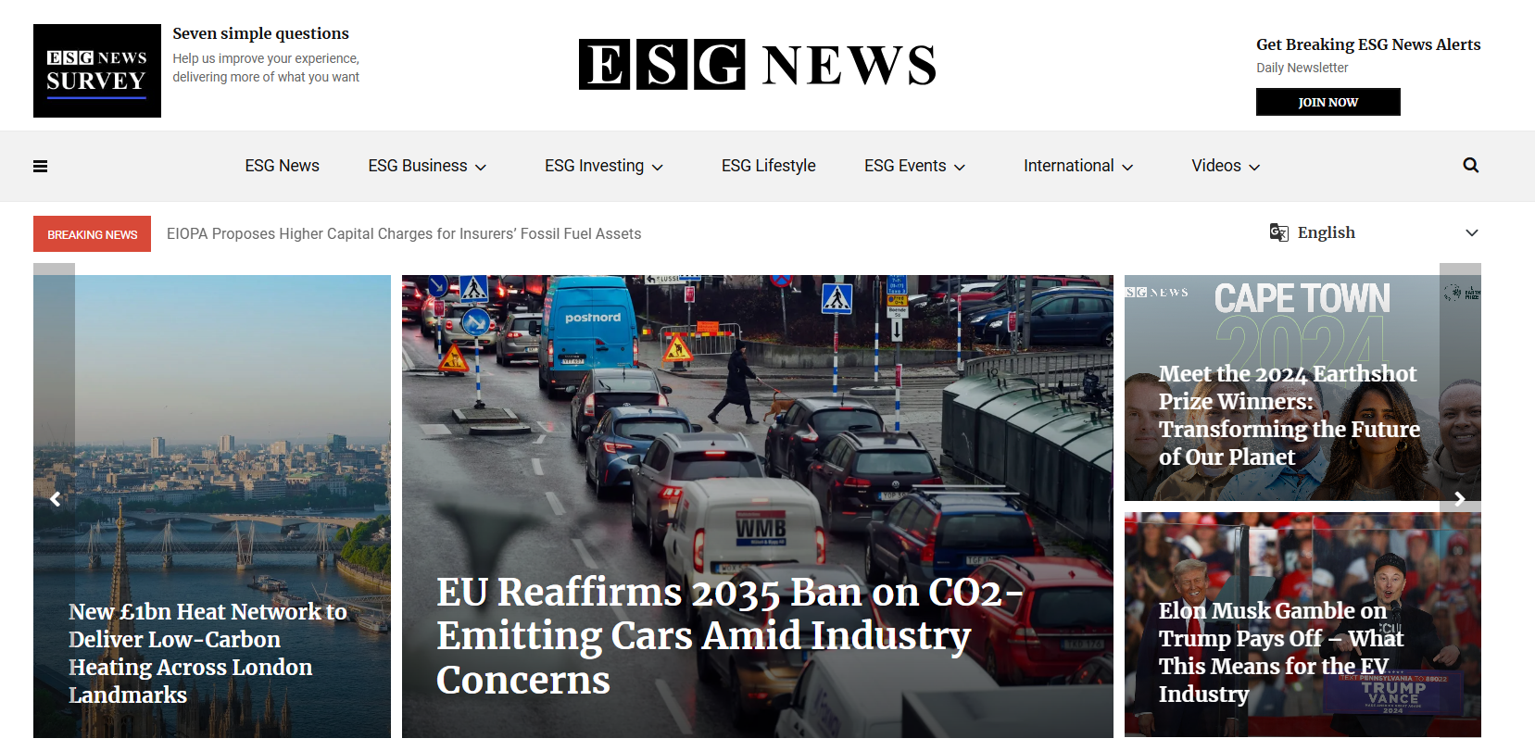
Researcher agent
scraping pe listafirme.ro (nume firma/cui) si
Stiri legate de esg

Slide 3
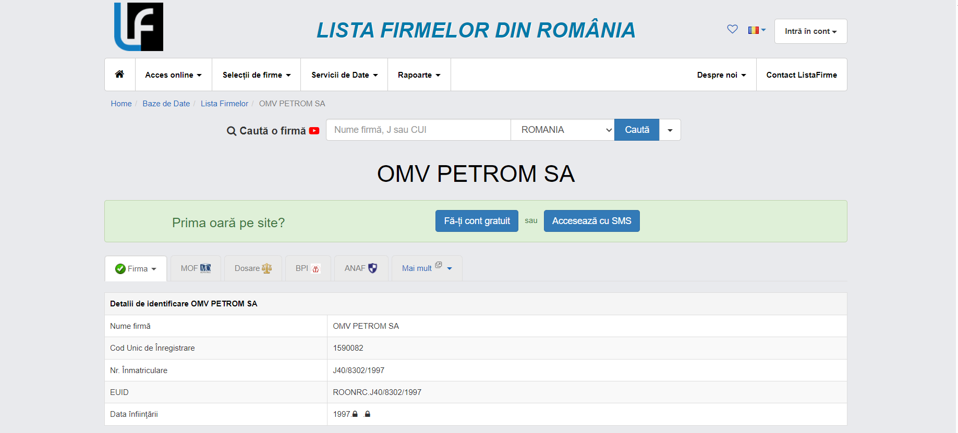
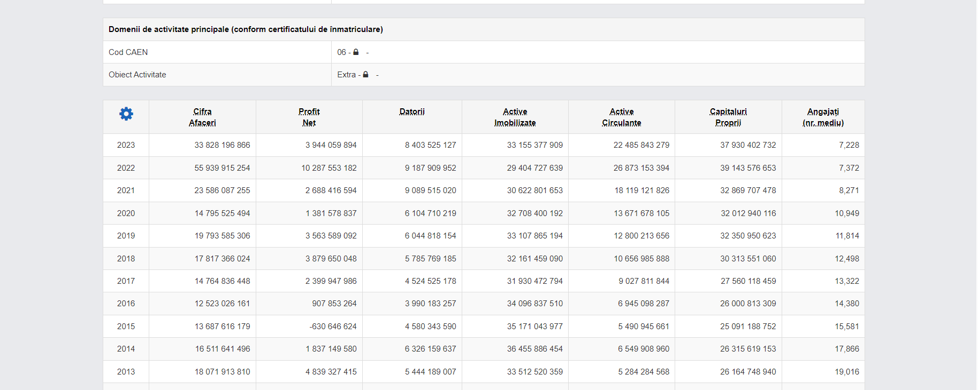
Extraction agent
Extragem informatiile relevante

Slide 4
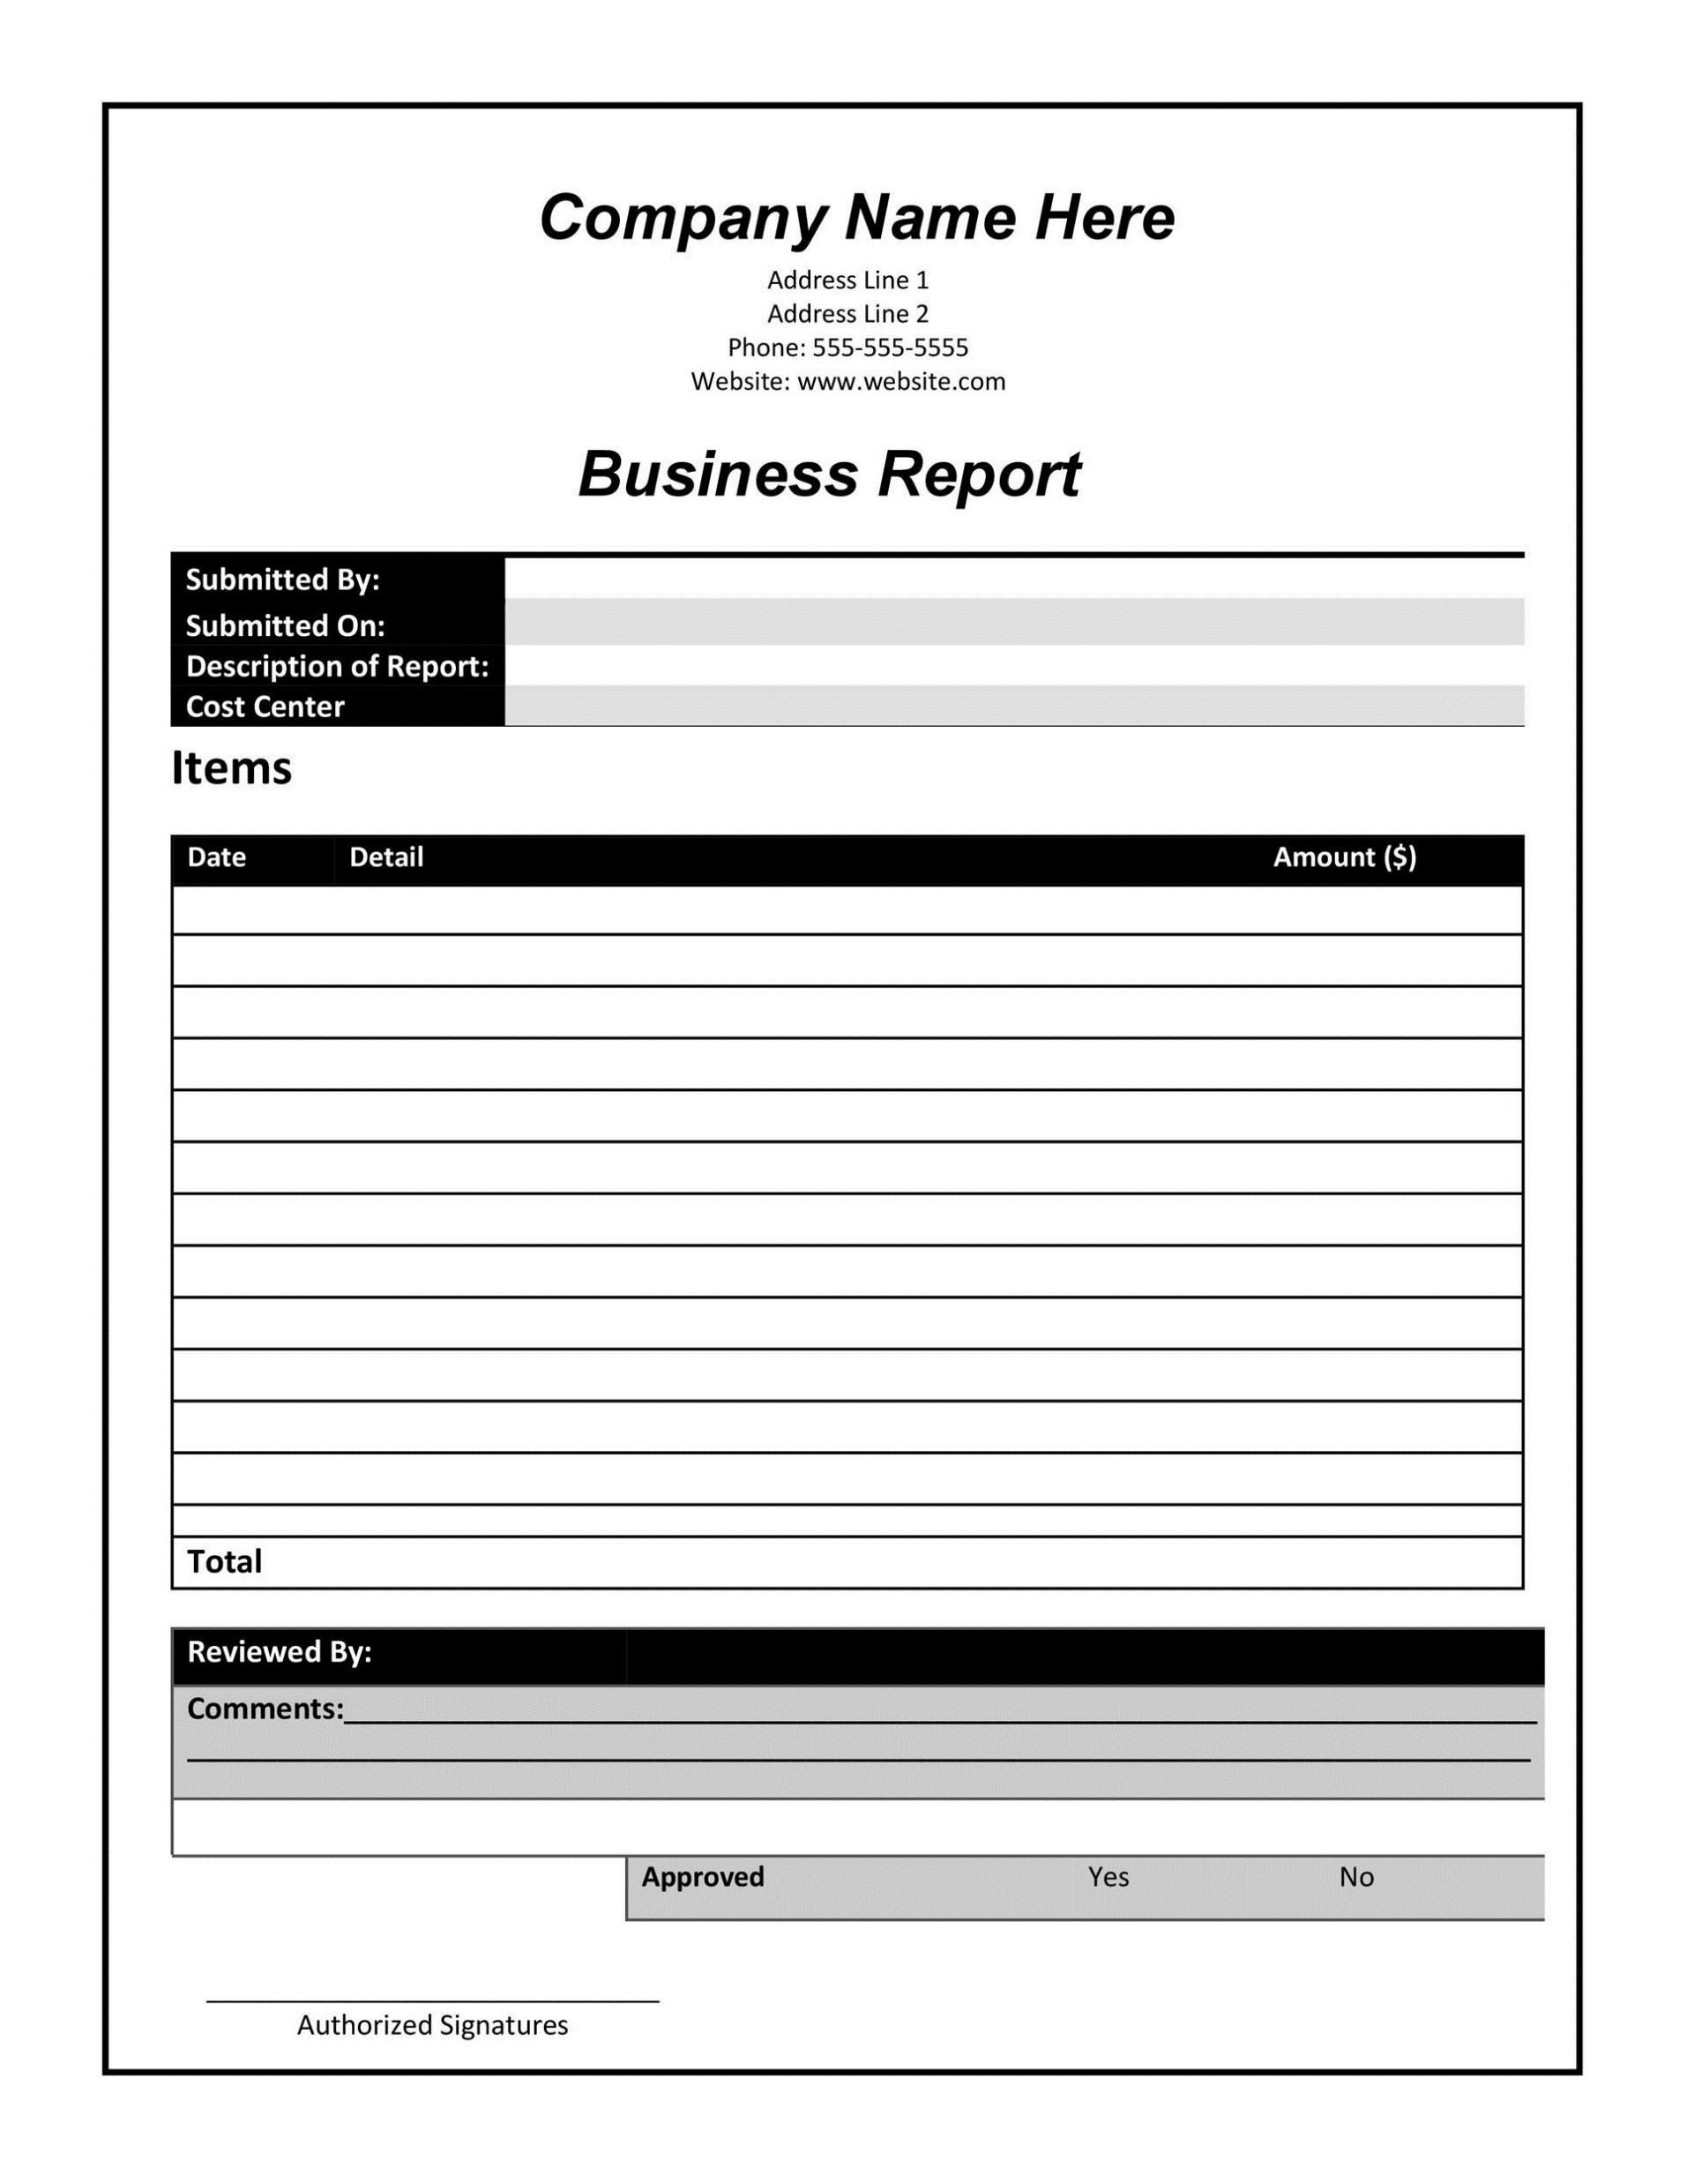
Aggregation agent
Agregam informatiile relevante intr-un raport structurat

Slide 5
Usage scenarios
Report generation
Question answering chatbot
Both (integrated using an agent)

Slide 6
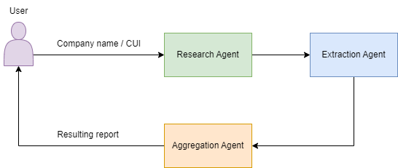
Report generation

Slide 7
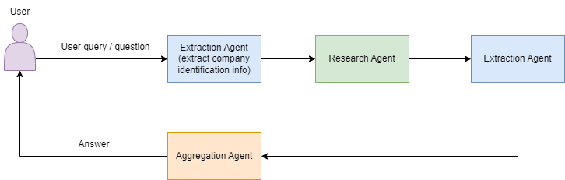
Question answering chatbot

Slide 8

be an agent to innovation

